Slide 1
Deep-Learning and HPC to Boost Biomedical Applications for Health
High-Performance Computing (HPC)
and Deep Learning Training Operations
Eduardo Quiñones
eduardo.quinones@bsc.es
Barcelona Supercomputing Center
DeepHealth Winter School – 24 January 2022

Slide 2
Agenda
Motivation: HPC and Cloud Computing
The Parallel Nature of Deep Learning Training Operation
Introduction to Parallel Execution
Parallel Strategies: Model and Data Parallelism
Data Parallelism: Parallel Performance vs. Accuracy Trade-off
Parameter Aggregation
Data-Shuffling
Distribution of Deep LearningTraining with the DeepHealth HPC Infrastructure
Inter-node Parallelism
Intra-node Parallelism

Slide 3
Motivation: HPC and Cloud Computing

Slide 4



DEEPHEALTH, a H2020 European innovation Project that aims to push the use of technology for Health to boost new and more efficient biomedical image applications for the diagnose, monitoring and treatment of diseases.
HPC/Cloud infrastructures
to train Deep Learning models

Slide 5


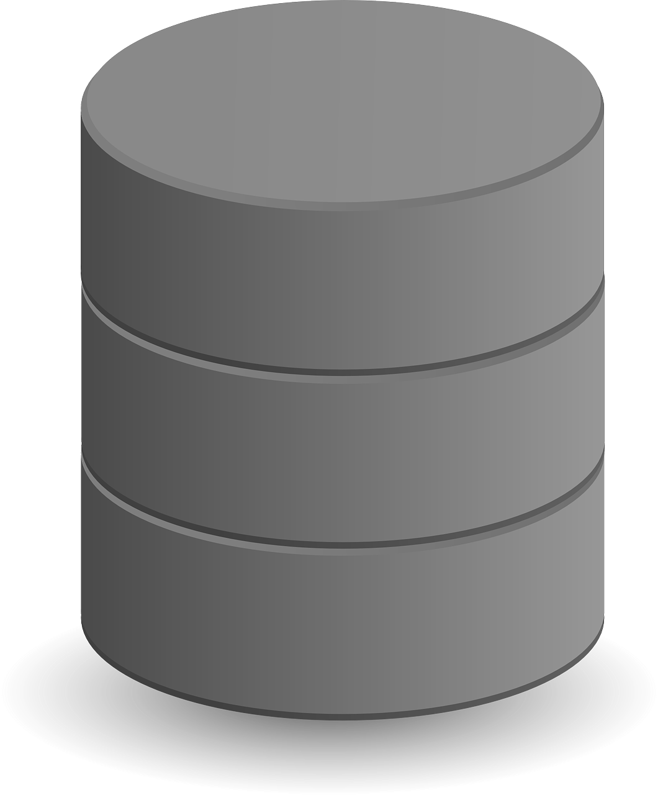



High Performance Computing (HPC)
HPC+Cloud
infrastructure
SOFTWARE PLATFORM
BIOMEDICAL APPLICATION
Platform uses the toolkit to train models (optional)
TOOLKIT
(EDDLL+ ECVL
Medical image
(CT , MRI , X-Ray,…)
New image to be analysed
Data used to train models
BIOMEDICAL IMAGE DATASET
Use toolkit to train predictive models
Prediction
Score and/or highlighted RoI returned to the doctor
Add validated images
(Optional) Train predictive models using the platform and the toolkit
Health professionals
(Doctors & Medical staff)
Using loaded/trained predictive models
Load trained predictive models to the platform
Images labelled by doctors
Samples to be pre-processed and validated
ICT Expert users
Images pending to be pre-processed and validated
Production environment
Training environment

Slide 6
High Performance Computing (HPC)
Refers to the aggregation of multiple (many) computing elements to deliver the level of performance needed to solve large problems
Hardware elements suitable for the problem to be solved
Many-cores CPUs, GPUs, FPGAs
Software frameworks to distributed the problem to effective exploit the performance capabilities of the HPC architecture
Parallel programming models, e.g.,
OpenMP (shared memory architectures)
CUDA, OpenCL (GPU/FPGA)
MPI and COMPSs (distributed memory), etc.
DeepHealth considers technologies suitable for Deep Learning
GPUs/FPGAs computing architectures
Parallel programming models supporting shared (OpenMP) and distributed memory (COMPSs) and accelerator devices (GPU/FPGA)

Slide 7
HPC Cloud Computing
Cloud computing is an execution model that abstract the deployment and execution to facilitate the outsourcing of public/private computing resources
Multiple execution models supported: IaaS, PaaS, CaaS, FaaS
Used of containers to encapsulate the execution environment
HPC+Cloud computing refers to the use of HPC technology to distribute coomputation upon cloud abstractions
The performance may be impacted by the execution and communication abstractions used
DeepHealth provides a unified framework adapted to exploit underlying heterogeneous HPC and cloud infrastructures
HPC parallel programming models (COMPSs)
Kubernetes and Docker frameworks for GPU abstraction

Slide 8
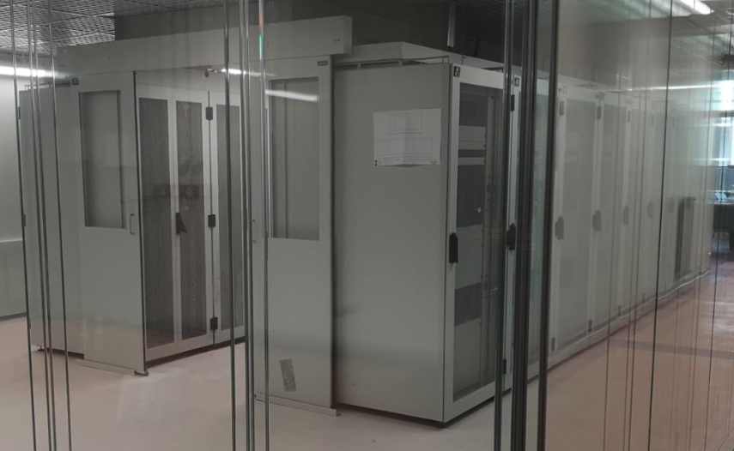
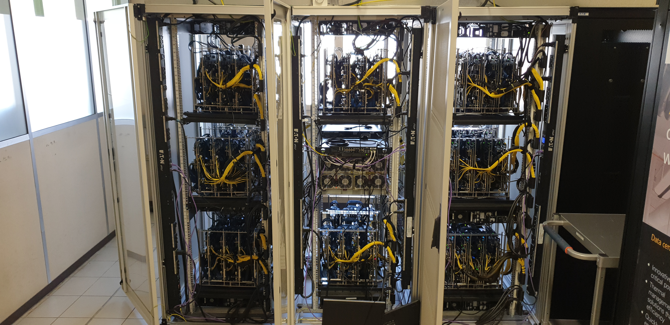
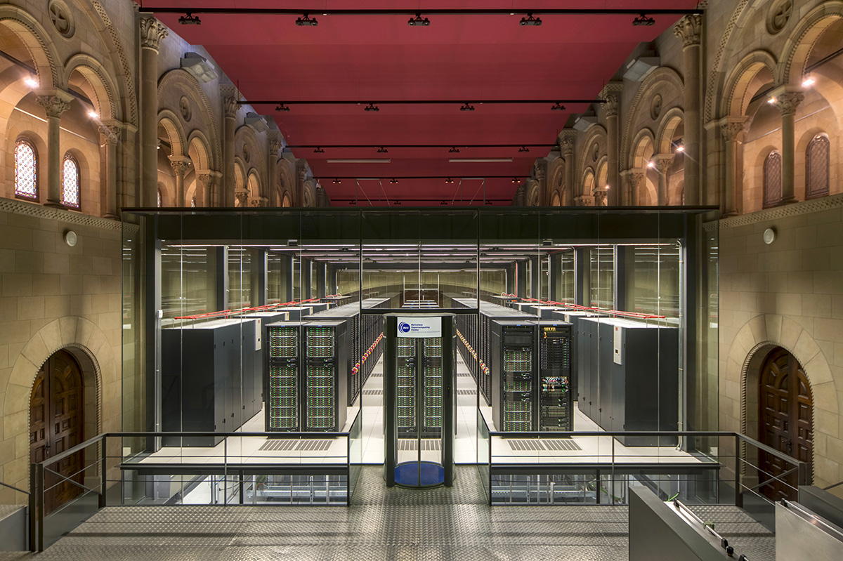
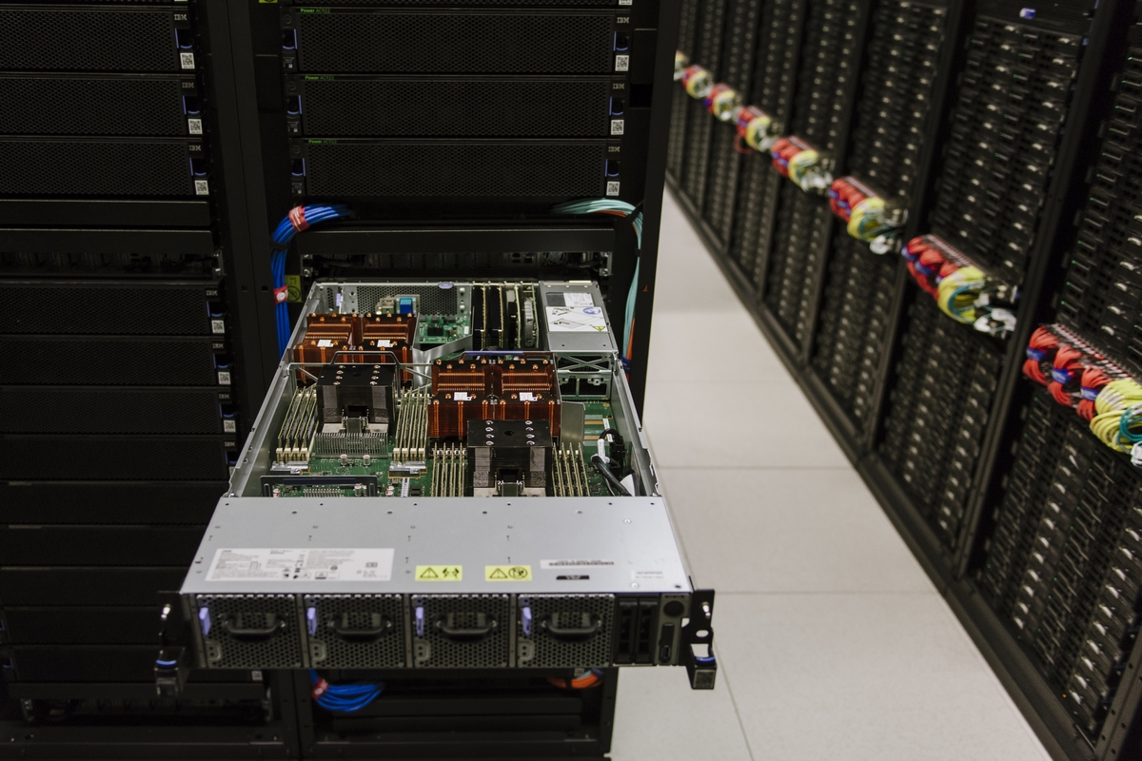


Motivation: A highly heterogenous HPC and cloud computing ecosystem
Kubernetes cluster of 16 nodes, each 80-core Intel + 4 V100 GPUs
8 clusters, each with 12 FPGAs + DDR memories + IO boards)
48 racks with 3456 nodes, each with 2 Intel Xeon Platinum
54 nodes, each 2 POWER9 + 4 V100 GPUs
HPC4AI at UNITO (Cloud- and GPU-based)
Experimental MANGO prototype at UPV (FPGA based)
Public Cloud
Marenostrum Supercomputer at BSC (CPU- and GPU-based)
A dedicated solution is needed for each computing platform

Slide 9
Motivation: A highly heterogenous HPC and cloud computing ecosystem
Kubernetes cluster of 16 nodes, each 80-core Intel + 4 V100 GPUs
8 clusters, each with 12 FPGAs + DDR memories + IO boards)
48 racks with 3456 nodes, each with 2 Intel Xeon Platinum
54 nodes, each 2 POWER9 + 4 V100 GPUs
HPC4AI at UNITO (Cloud- and GPU-based)
Experimental MANGO prototype at UPV (FPGA based)
Public Cloud
Marenostrum Supercomputer at BSC (CPU- and GPU-based)
DeepHealth Project

Slide 10
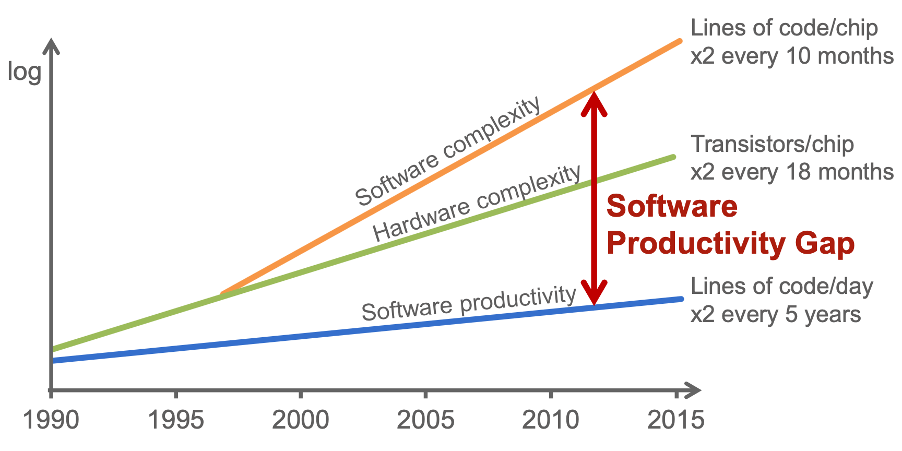
SW Development Complexity
Parallel programming model to efficiently:
Describe parallelism
Exploit parallelism by distributing the computation
Source: ITRS & Hardware-dependent Software, Ecker et al., Springer

Slide 11







The DeepHealth HPC Infrastructure
Exploit the performance capabilities of heterogenous HPC and cloud computing infrastructures featuring GPU, CPU, FPGAs
Inter-node parallelism: Data-sets are split and distributed across multiple computing nodes interconnected among them
Intra-node parallelism: Deep learning operations are efficiently assigned to parallel resources according to the execution model of the processor architecture, e.g., CPU, GPU, FPGA
Increase the productivity (programmability, portability, performance) of software development
HPC+Cloud
infrastructure
Inter-node parallelism
Intra-node parallelism

Slide 12
The Parallel Nature of Deep Learning Training Operation: Parallel Performance vs. Accuracy

Slide 13
Parallel Execution
A fundamental aspect is to identify the parallel nature of the problem to exploit the performance capabilities of the HPC infrastructure
Identify the units of computation that can execute in parallel
Identify the order of execution and communication using synchronization mechanisms
3. Properly distribute the parallel units across the resources
resource 1
f1
f2
f3
f4
✘
resource 2
in1
in2
in3
o1=f1(in1)
o2=f2(in2)
o3=f3(in3)
f4(o1,o2,o3)
resource 1
f1
f3
f4
✘
f1
f2
f3
resource 2
f2
o2
o1
o3
f4
resource 1
f1
f2
f4
✔︎
resource 2
f3
task dependency graph (TDG) or
direct acyclic graph (DAG)

Slide 14
Parallel Execution
The network communication and synchronization overheads to manage the parallel execution may overwhelm the benefits of parallel execution
With communication overheards
Without communication overheards
resource 1
f1
f3
f4
resource 1
f1
f3
f4
✘
resource 2
f2
comm.
✔︎
resource 2
f2
resource 1
f1
f2
f4
resource 1
f1
f2
f4
✔︎
resource 2
f3
comm.
✘
resource 2
f3
To take full benefit of HPC we need to identify the parallel nature of the problem: the Deep Learning Training Operation

Slide 15
Deep Learning Training Operation
Is trainning suitable for parallel execution?
A highly computational intensive task to compute the parameters (weights and biases) of a DNN, based on an input data-set
The computing step (Gradient Descent):
The data-set is shuffled and organized in batches
Each element of a batch is processed sequentially by:
A forward to estimate the loss
A backpropagation that optimises all DNN layers based on the loss
When a batch is finished, the parameters of the model are updated and step 2 is repeated until all the data-set is processes (an epoch)
Steps 1 to 3 are repeated until the DNN accuracy is acceptable
train data-set
shuffling and
batch
(step 1)
forward-backprop.
(step 2)
Model update (step3)
Accuracy achieve? (step4)

Slide 16
Deep Learning Training Operation
Is trainning suitable for parallel execution?
Tha execution nature of a training operation is sequential
Three parallelised strategies for distribute the computation (can be combined)
Forward and back propagation operations are optimized to execute on a single GPU/many-core CPU with CUDA/OpenMP programming models
Model parallelism: Different network layers are distributed in different resources
Data parallelism: The data-set is divided and each distributed resource trains it with a local model
Data Parallelism
Model Parallelism
train data-set
shuffling and
batch
(step 1)
forward-backprop.
(step 2)
Model update (step3)
Accuracy achieve? (step4)

Slide 17
Model Parallelism
Is trainning suitable for parallel execution?
Different (distributed) resources computes different layers of the DNN
DNN
res.1
res.1
res.1
train data-set
shuffling and
batch
(step 1)
Model update (step3)
Accuracy achieve? (step4)
res.2
(step2)

Slide 18
Data Parallelism
Is trainning suitable for parallel execution?
Different (distributed) resources have a local copy of the DNN and subset of the data-set upon which the training is applied
At the end of each sub-train, local parameters must be aggregated
res.M
forward-backprop.
(step 2)
Model update (step3)
…
res.2
forward-backprop.
(step 2)
Model update (step3)
Model aggregation (step3.5)
Accuracy achieve? (step4)
train data-set
shuffling and
batch
(step 1)
res.1
forward-backprop.
(step 2)
Model update (step3)

Slide 19
Model vs. Data Parallelism
Model parallelism
Very limited exploitation of parallelism with fine-grain execution
May suffer parallel execution overheads when communicating layers
Convenient for very large DNN models
Deep Learning training operation is suitable for parallel execution
✔︎
Data parallelism
Fully exploits the parallel performance capabilities of HPC infrastructures
A new parameter aggregation step is needed
A coarse synchronization
Communication of parameters

Slide 20
Data Parallelism
The distributed training execution is composed of two computing elements
Master Node (a.k.a. parameter server) responsible of:
Distributing the DNN model and the dataset chunks to the different computing resources
Collecting the parameters from each local training and aggregate them properly
Redistribute the new aggregated parameters back to the local model
Worker Node: responsible of:
Receiving the model and the corresponding dataset chunk from the master node
Training each local model and sending back model parameter changes
model/data-set distribution
data-set
batch
1
2
3
trainning
parameter aggregation
trainning

Slide 21
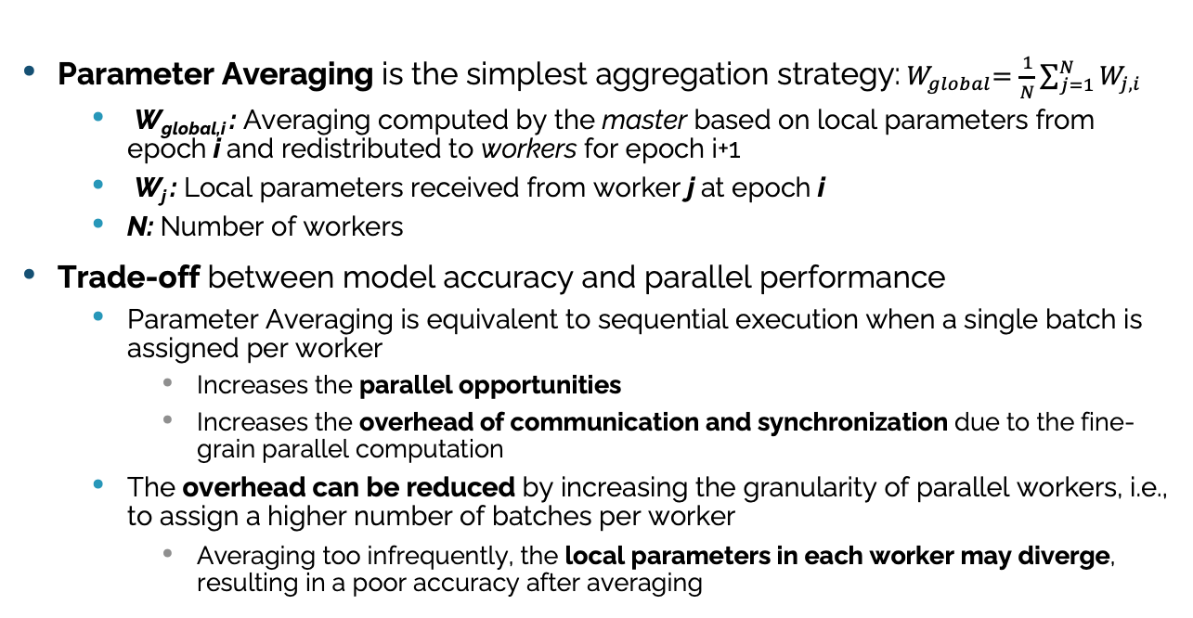
Synchronous Parameter Aggregation
Data Parallelism
Parameter Averaging is the simplest aggregation strategy:${ W}_{global}=\frac{1}{N}\sum_{j=1}^{N}{W_{j,i}}$
W_{global,i} : Averaging computed by the master based on local parameters from epoch i and redistributed to workers for epoch i+1
W_{j} : Local parameters received from worker j at epoch i
N: Number of workers
Trade-off between model accuracy and parallel performance
Parameter Averaging is equivalent to sequential execution when a single batch is assigned per worker
Increases the parallel opportunities
Increases the overhead of communication and synchronization due to the fine-grain parallel computation
The overhead can be reduced by increasing the granularity of parallel workers, i.e., to assign a higher number of batches per worker
Averaging too infrequently, the local parameters in each worker may diverge, resulting in a poor accuracy after averaging

Slide 22
Synchronous Parameter Aggregation Trade-offs
Data Parallelism
single batch
per worker
Multiple batches
per worker
1
2
3
4
5
6
1
2
3
4
5
6
Higher communication synchronization costs
Lower communication synchronization costs
Higher Model Accuracy
Lower Model Accuracy
Higher degree of parallelism
Lower degree of parallelism

Slide 23
Asynchronous Parameter Aggregation
Data Parallelism
A synchronization barrier is placed before averaging to ensure the completion of all workers for averaging
It can be relaxed by:
At the completion of worker j, parameters W_{j} are sent to the master
Master uses W_{j} to update a partial W_{global}, which is sent back to worker j that can continue the execution
The worker initiate a new training with partial information from the workers previously completed
It can be completely remove by not sharing the local parameters with the master and letting workers to continue the execution
The local parameters in each worker may diverge, resulting in a poor accuracy
This effect can be minimised by synchronizing parameters after a given number of epochs

Slide 24
Asynchronous Parameter Aggregation
Data Parallelism
Relaxing Synchronzation
Removing Synchronzation
1
2
3
4
5
6
1
2
3
4
5
6
Even lower communication synchronization costs
lower communication synchronization costs
Even Higher degree of parallelism
Master nodes are executed sequentially with an order not determined by the dependency
Even lower
Model Accuracy
Higher degree of parallelism

Slide 25
The impact of Data Shuffling
Data Parallelism
At every model update (batch), a data-set shuffling operation is needed
When the data-set is distributed, shuffling operations may impact on the parallel performance of trainning operation due to synchronization and communication costs
Three shuffling strategies are defined
Global. The complete data-set is shuffled across multiple computing nodes
Selective. A subset of the data-set stored across multiple computing nodes is shuffled (based on the global data-set)
Local. Shuffle operation only occurs within computing nodes
Each shuffling strategy fits better with a data parallelism approach
Global shuffling is applied to synchronous parameter averaging
Selective shuffling is applied to relaxing synchronization
Local is applied is applied to removing synchronization

Slide 26
Global Data-Set Shuffling
Data Parallelism
Synchronous parameter averaging initiate the training of a new epoch synchronously
Global shuffling can be safely applied at every new epoch
All workers receive from the master a new data-set chunck to be processed
The communication overhead is increased
Synchronous Parameter Averaging
1
2
3
4
5
6
2
5
6
1
3
4
6
4
1
2
3
5

Slide 27
Selective Data-Set Shuffling
Data Parallelism
Relaxing synchronization does not implement the concept of epoch
Workers initiate a new training with the partial information provided by the master
The master provides a shuffled data-set chunk to the worker initiating a new training
The communication overhead is reduced as few information is transmitted
Relaxing Synchronzation
1
2
3
4
5
6
5
3
2
6
1
4
6
2
5
1
4
3

Slide 28
Local Data-Set Shuffling
Data Parallelism
Each worker shuffles its local data-set chunck as soon as a new training is initiate with no master intervention
The communication is completely remove
Removing Synchronzation
1
2
3
4
5
6
1
2
3
4
5
6
1
2
3
4
5
6

Slide 29
Parallel Performance vs. Accuracy Trade-off
Data Parallelism
Parallel Performance
-
+
+
-
Accuracy

Slide 30
Distribution of Training with the DeepHealth HPC Infrastructure

Slide 31
Parallel Programming Models
A set of programming elements to describe the parallel behaviour of an application and abstract the complexities of the underlying parallel platform
Granularity level of parallelism exploited: instruction, statement, loop, procedural
Synchronization model: coarse-grain, fine-grain
Execution model: fork-join, thread-pool, etc.
Memory model: Shared, distributed
Mandatory to properly describe the parallel nature of the application

Slide 32


Parallel Programming Models
Mandatory to enhance productivity
Programmability. Abstracts the parallelism while hiding the underlying computing platform complexities
Portability/scalability. The same source code is valid in different parallel platforms
Performance. Rely on run-time mechanisms to exploit the performance capabilities of parallel platforms
Parallel Programming Models
Conventional Models

Slide 33
Types of Parallel Programming Models
Hardware-centric
Provide a user-friendly interface to tune the application to native platform features, e.g., NVIDIA CUDA
None portable
Application-centric
The application must fulfill the execution model to exploit parallelism facilitating portability, e.g. OpenCL
May require a full rewriting process of the application, impacting on programmability
Parallelism-centric
Parallelism is expressed by means of constructs various levels of abstraction, e.g. POSIX threads, OpenMP, OpenACC, MPI, COMPSs, Spark, Ray
This approach allows flexibility and expressiveness, while decoupling design from implementation

Slide 34
Exploitation of Parallel Capabilities of HPC Infrastructures
A set of parallel programming models needed to properly describe the parallelism of training operations an efficiently exploit
Inter-Node Parallelism: Distribute training operations across multiple computing nodes
Intra-Node Parallelism: Efficient execution of forward/backpropagation operations within heterogeneous computing nodes
Distribute
Cloud
CPU
CPU
CPU
CPU
GPU
GPU
FPGA
GPU

Slide 35
Distribute training operations
COMPSs task-based framework (BSC) used to distribute training operations
Parallelism exposed within the sequential source code (Python, Java, C++) in the form of tasks and data dependencies existing among them, hiding infrastructure complexities
Agnostic of computing platform: HPC and cloud (public/private) resources supported
Synchronous/asynchronous parameter aggregation training strate
Global, local/selective shuffling strategies
@task(c=IN)
def print(c):
@task(a=IN,b=IN,c=OUT)
def add(a, b, c):
c = a + b
for i in range(MSIZE):
add(A[i],B[i],C[i])
print(C)
add
add
…
add
print
Cloud
1
CPU
CPU
3
CPU
2
CPU
GPU
GPU
FPGA
GPU

Slide 36
Distribute training operations
Comparison of synchronous/asynchronous training of CIFAR10 executing on:
Marenostrum Supercomputer: 3456 nodes, each featuring 2 Intel Xeon with 48-cores and 96GB of memory
Syncrhonous
Asyncrhonous

Slide 37
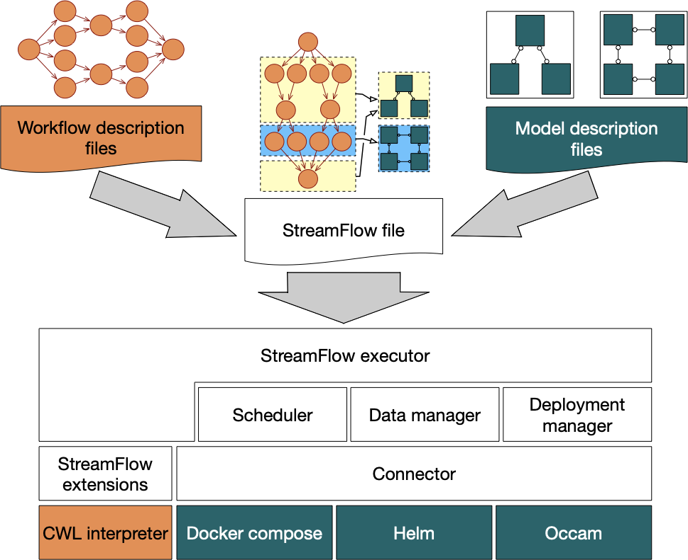
Distribute training operations
StreamFlow (UNITO) used to orchestrate the execution of multiple training workflows into the HPC4AI infrastructure
Declarative description of many multi-container environments to orchestrate the deployment and execution of the application on target infrastructure
The workflow description includes application steps and data dependency (CWL)
The model description defines the target infrastructures capability
Dataset 1
(train/test)
Cloud
Dataset 2
(train/test)
CPU
1
3
CPU
2
CPU
1
2
3
CPU
GPU
GPU
FPGA
GPU

Slide 38
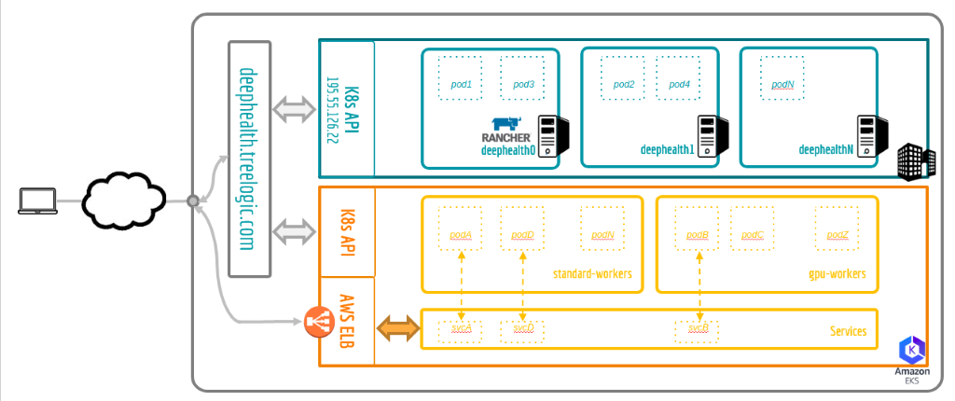
Distribute training operations
An hybrid cloud (TREE) supporting private and public (AWS) cloud to facilitate management and security tasks based on Kubernetes clusters
A RESTful API to simplify the deployment and management of COMPSs workflows
Rancher to manage the operational and security challenges on multiple Kubernetes clusters
A VPN to facilitate to provide a secure COMPSs - Hybrid Cloud communication to deploy in the different Kubernetes clusters
DH hybrid cloud
Private Cloud
Dataset 1
(train/test)
CPU
CPU
CPU
2
CPU
GPU
GPU
1
3
FPGA
GPU

Slide 39
Distribute training operations
Comparison of synchronous/asynchronous training of CIFAR10 executing on:
Marenostrum Supercomputer: 3456 nodes, each featuring 2 Intel Xeon with 48-cores and 96GB of memory
Syncrhonous
Asyncrhonous
DH Private Cloud: 3 nodes, each featuring a 8-core Intel Xeon with 16 GB of memory

Slide 40
Heterogeneous execution of EDDL Kernels
Distribute the execution of forward /backpropagation EDDL kernels across CPU and acceleration devices to achieve better performance/energy efficiency
Used of OpenMP (for CPU), CUDA (GPU) and OpenCL (FPGA) for improved performance
CPU
2
relu
m2D
GPU
relu
conv
m2D
FPGA
Memory
conv

Slide 41
OpenMP and CUDA optimization
The EDDL has been optimized to execute in shared-memory multicore and GPU enviroments for inference and training
Parallel execution of internal training operations
96GB of memory + 2 sockets of Intel Xeon Platinium, each with 24-cores
Power9 + NVIDIA V100

Slide 42
Conclusions
Deep Learning training operations are suitable for parallel execution
Data-parallelism: parameter averaging and data-shuffling strategies
Tradeoff between parallel performance and accuracy
The DeepHealth HPC platforms enables EDDL/ECV libraries to exploit the performance capabilities of HPC/Cloud computing infrastructures
A task-based model (COMPSs) to describe the parallelism of training operations (synchronous/asynchronous), agnostic to the underlying platform
A workflow orchestrator (StreamFlow)
An hybrid cloud solution to combine private a public (AWS) cloud resources
The use of parallel programming models (OpenMP, CUDA, OpenCL)

Slide 43
Thank you!
Eduardo Quiñones
eduardo.quinones@bsc.es

